Slide 1
STOMACH
Dr Reshmy K.R
Professor
Dept.of Physiology
SKHMC

Slide 2
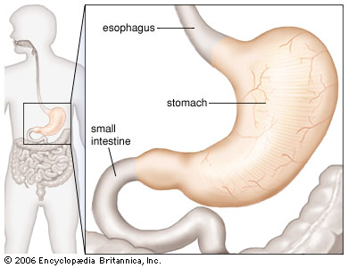
STOMACH
Hollow organ situated just below the diaphragm on the left side in the abdominal cavity.
volume at empty -50ml
expand upto 1-1.5 litres of solids and liquids.

Slide 3
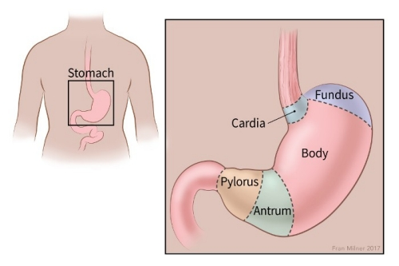
Parts of the stomach
Cardiac region
Fundus
Body or Corpus
Pyloric

Slide 4
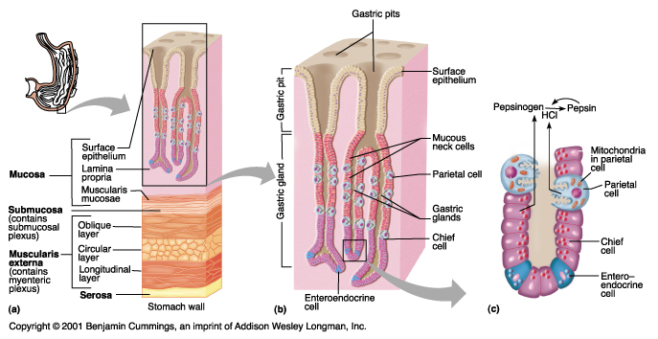
Structure of wall of stomach
Outer serous layer
Muscular coat
Submucus layer
Inner mucus layer

Slide 5
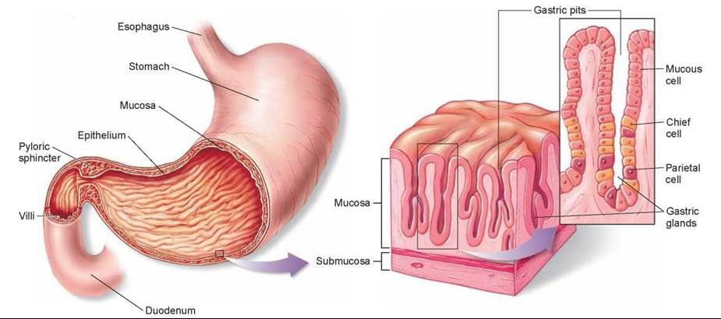
Classification of glands of stomach
Fundus glands- in fundus & body of stomach
Pyloric glands-pyloric part of stomach
Cardiac glands-cardiac region of stomach

Slide 6
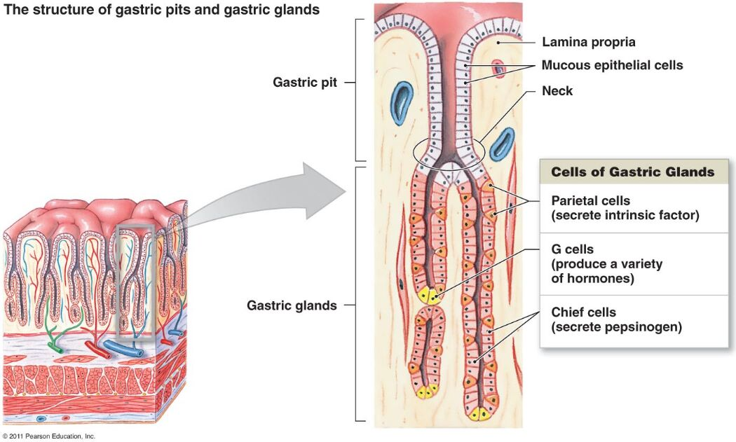
Structure of Gastric glands
Chief cells/pepsinogen cells- secrete pepsinogen, rennin, gelatinase
Parietal cells/oxyntic cells-secrete Hcl, Intrinsic factor of Castle
- presence of Canaliculi
empty their secretions into the lumen of the gland through these canaliculi
Mucus neck cells secrete mucin

Slide 7
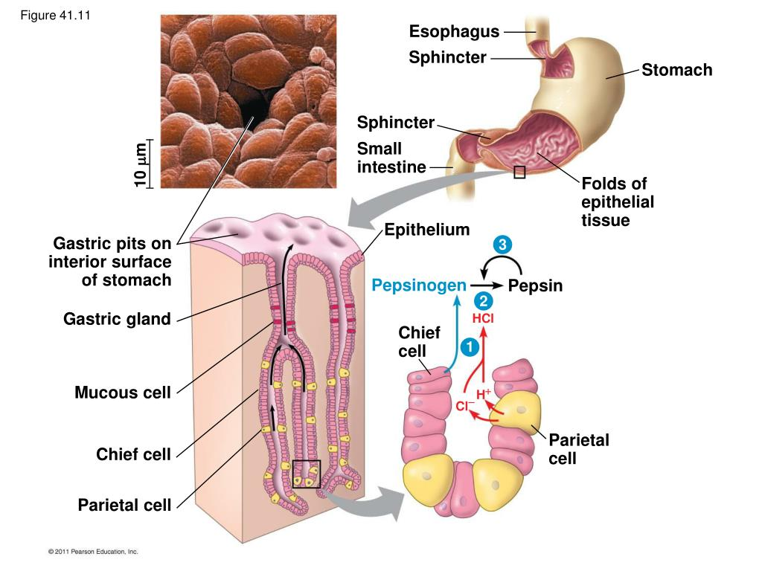
Gastric pits

Slide 8
Functions of gastric glands

Slide 9
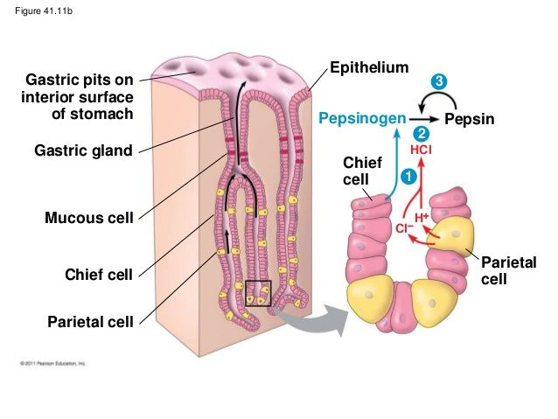
Mechanism of secretion of HCL

Slide 10
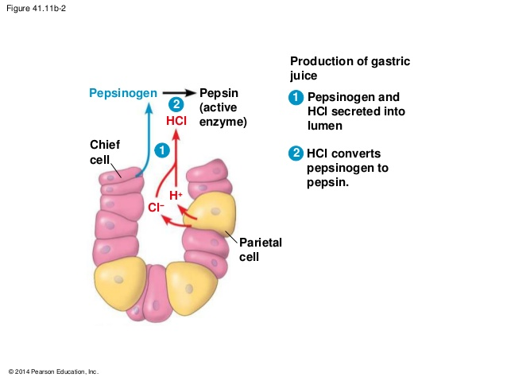

Slide 11
Functions of stomach
Storage function
Mechanical function
Digestive function
Protective function
Hemopoietic function
Excretory function

Slide 12
properties & composition
Gastric Juice is the mixture of secretions from different glands of the stomach
Properties
volume -1200-1500ml
reaction highly acidic
pH- 0.9-1.2 due to the presence of Hcl
Sp.g-1.002-1.004
Composition
Gastric Juice
Water 99.5% solids 0.5%
organic Inorganic
Enzymes, mucus, Intrinsic factor

Slide 13
Inorganic solids
sodium
calcium
potassium
chloride
bicarbonate
phosphate
sulfate
Gastric enzymes
Pepsin- Proteolytic enzyme
Rennin
Gastric Lipase
Gelatinase
Urase

Slide 14
Functions of Gastric Juice
1.Digestive function
Pepsin
Proteins proteoses, peptones , polypeptides
gastric lipase
Lipids Fatty acids& Glycerol
Gelatinase acts on gelatin
Urase acts on urea produces ammonia

Slide 15
2. Hemopoietic function - Intrinsic factor helps in the absorption of Vitamin B12. Deficiency leads to Pernicious anemia
3.Protective function - mucus lubricates the gastric mucosa , protect from irritation
-prevents the digestive action of pepsin on the wall of the stomach
-acid combining power, mucus protects the gastric mucosa from Hcl
4.Functions of Hcl
-actvates pepsinogen to pepsin
-bacteriolytic action
-acidity of the chyme causes release of hormones secretin & cholecystokinin
-medium for the cation of enzymes

Slide 16
reference
2001 Benjamin Cummings an imprint of Addisons Wesley Longmans Inc
https://www.slideserve.com/orly/animal-nutrition
https://courses.lumenlearning.com/suny-ap2/chapter/the-stomach/
THANK YOU

